Slide 1

MetaNaviT
John, Kaitlyn, Tanish, Deepti, Carlana, Jose, Kantaro
(CS 461)

Slide 2
What is MetaNaviT?
MetaNaviT is an AI powered tool designed to organize, analyze, and transform your files.
Provides customizable solution for managing files based on user defined criteria and workflow
Features:
Support for handling diverse file type and large scale directories
Customizable sorting algorithm for personalized file management
Capabilities to transform and consolidate data, such as merging columns across multiple CSV files
Notes:
Hello everyone, We are MataNaviT, and I am Carlana So. MetaNaviT is an AI-powered tool designed to simplify how we interact with and manage files which help users organize, ana lyze, and transform their files seamlessly.
It will also help you when you're dealing with a cluttered directory or trying to make sense of diverse file types.
Some key features are
Support for diverse file types and large-scale directories, so No matter the size or variety of files, MetaNaviT can handle them efficiently.
Customizable sorting algorithms, which the users can define their own criteria for file management, ensuring the tool fits their unique workflow.
And finally, data transformation and consolidation capabilities: For example, MetaNaviT can merge columns across multiple CSV files, streamlining your data processing tasks.
The goal is to.

Slide 3
Functional Requirements (User Stories)
Requirements
Resource-Agnostic Metadata Search
Cross-Resource Deep Copy Extraction
Comprehensive Resource Mapping
User-Adaptability
Chatbot
Content Extraction and Summarization
Real-Time Indexing
Interactive Visualization
Structured Data Extraction from Unstructured Sources
Notes:
Kantaro:

Slide 4
Non-Functional Requirements
Requirements
Fast Response Time (Performance Requirements)
Reliable Access to Resources (Reliability Requirements)
Intuitive GUI (Usability Requirements)
Deployable Software Across Various Environments (Portability Requirements)
Optimize Memory and CPU Usage (Efficiency Requirements)
Support Multiple Data Sources (Compatibility Requirements)
Notes:
Kantaro:

Slide 5
Milestones and Timeline
Tasks | Completion date
RAG Model Setup | 12/01/24
Test Cases for RAG model Performance | 12/14/24
File Processing | 12/24/24
Vector Database | 01/24/25
Resource Extraction (Text File) | 01/24/25
User-Adaptability | 03/05/25
Resource Mapping | 03/05/25
Cloud Content Integration | 02/20/25
Image Processing | 01/24/25
Notes:
" Hi, my name is Deepti. Let’s review the updated milestones and timeline. We successfully completed the RAG Model Setup on December 1, 2024. Next, by December 14, we’ll finalize the Test Cases for RAG Model Performance to ensure optimal functionality.
Looking ahead, File Processing will be completed by December 24, and Image Processing will follow by January 24, 2025. On the same date, we’ll also finalize both the Vector Database and Resource Extraction, ensuring efficient data management and retrieval.
As we move into March, User Adaptability and Resource Mapping will be ready by March 5, allowing the system to align more closely with user needs. Lastly, we’re set to complete Cloud Content Integration by February 20, keeping everything on track for a successful rollout."

Slide 6
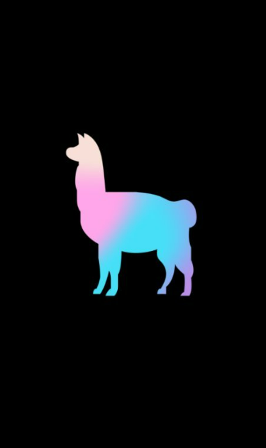
MetaNaviT Design
LlamaIndex: Used for managing data and LLM workflows
LLM: Llama2:7b for basic testing, Final model TBD
Resource Mapping: Generate resource maps for capturing relationships between files
Enable Efficient Retrieval + Support Contextual Relevance
Develop Data Structure: Identify or design structures to represent relationships and semantics effectively.
Prompt Engineering: Craft and optimize prompts to accurately generate resource maps aligned with user needs.
Notes:
Our core design contribution is creating a resource map that allows the LLM to efficiently navigate and capture the attributes and semantics of any file system resource. The backend team will be split into two groups: one group will ensure that collected metadata captures the necessary information and relationships, potentially through the use of a memory model. And the other group will be developing the resource map architecture. With our current research, our resource map will likely be similar to a hierarchical tree, but it would need added dimensions and/or hierarchies to capture the complexities of things like dependencies and associations. Once we finalize the architecture plan, we will primarily rely on prompt engineering workflows to generate the map using an LLM

Slide 7
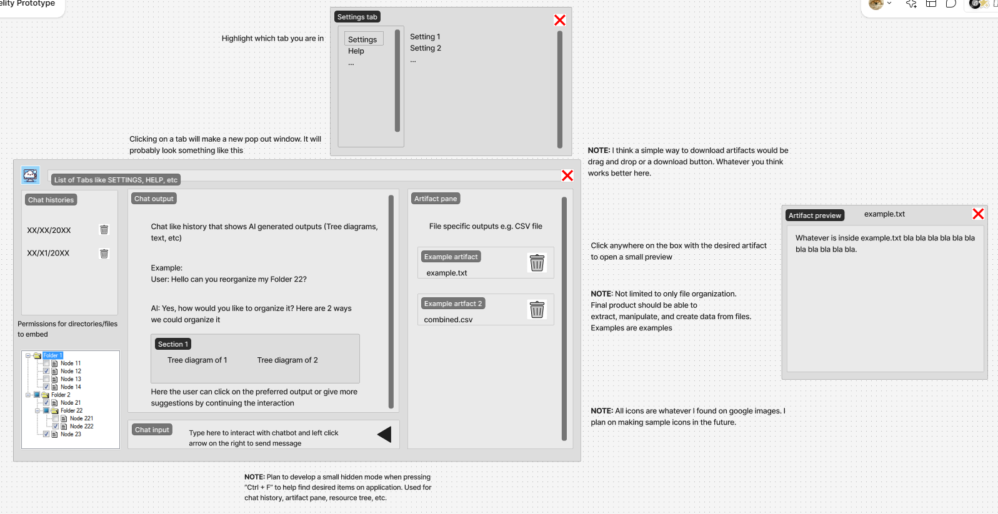
Prototypes & Demo
Notes:
Made by John

Slide 8
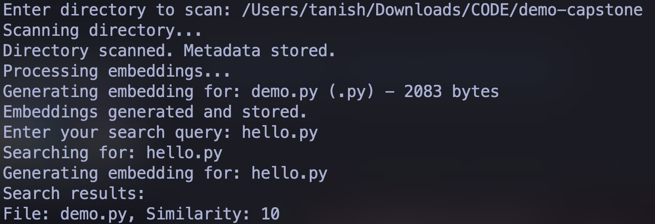
Prototypes & Demo

Slide 9
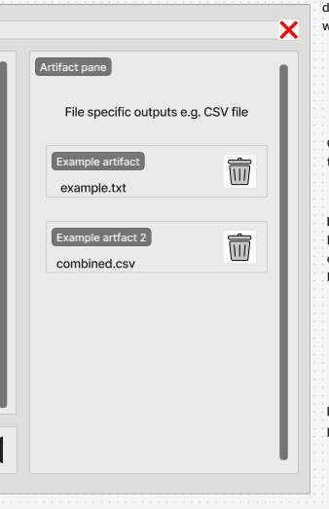
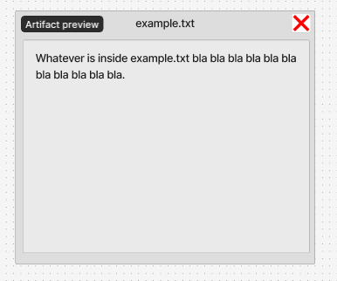
Product Related Feedback Throughout Term
GUI Wireframe
A dedicated tab to organize artifacts (PDFs, .py, .txt, etc)
Implement some sort of quick search method (e.g. Ctrl + F)
Demo
(Haven’t reviewed. We have sort of a Research x Software Project)
Notes:
Made by John

Slide 10

Current Status
Prototype Development:
Bare-bones Rag model
Research Focus:
Synthesize material into high-level and low-level summary
of the material
Looking at APIs to facilitate task
Algorithms to increase performance
Notes:
Hey Im Jose Sanchez and I will be presenting Current status, So far, we’ve built a basic RAG model using pgvector, a Postgres extension fo vector storage and similarity search. Most of our progress has involved researching APIs to enhance specific project sections.
We plan to implement clustering algorithms to extract key chunks from large datasets and explore Chonkie API for semantic chunking.

Slide 11
Next Steps
Resource Map Development:
Experimentation with organizational methodologies
Canonical structuring
Prompt Workflow
Function calling
AI Reasoning Development:
Creation of training data sets
Optimizing factors such as embedding and traversing resource tree
Notes:
Next Steps:
Our upcoming focus is on developing a Resource Map, which includes experimenting with canonical structures, incorporating prompt workflows, and function calling. Once that’s ready, we’ll work on reasoning development, which includes designing an algorithm to retrieve relevant information from the tree, defining heuristics, and training the model.
We’re excited about the potential impact of these developments and look forward to sharing our results soon. Thank you for your time!
.

